Slide 1

Your Enterprise Software Developer
TMA Overview

Slide 2

Final Present Reports
Mentor: NGUYEN TRUONG SON
Intern: NGUYEN VAN LOI
Catalog:
Network
Github
JAVA CORE
FE BASIC
SQL
JSP/ SERVLET

Slide 3

GitHub
Concept
Understand basic of Github:
+ Is a service that manages multiple versions of code.
+ All code and history are stored on the user’s machine.

Slide 4
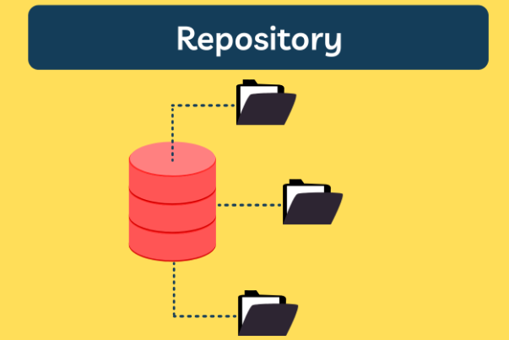
GitHub
Repository
Understand Repositpry of Github:
+ Is a place to store and manage source code, documents, and other project-related assets.
+ Contains source code, files, directories, change history.

Slide 5
GitHub
Clone
Understand about cloning a repository:
+ Is a service that manages multiple versions of code.
+ Create a copy of that repository on the computer.
+ Containing the entire change history and files of the repository.

Slide 6
GitHub
Commit
Understand Repositpry of Github:
+ Is a service that manages multiple versions of code.
+ All code and history are stored on the user’s machine.

Slide 7
GitHub
Pull
Understand Repositpry of Github:
+ Is a service that manages multiple versions of code.
+ All code and history are stored on the user’s machine.

Slide 8
GitHub
Push
Understand Repositpry of Github:
+ Is a service that manages multiple versions of code.
+ All code and history are stored on the user’s machine.

Slide 9
Network
Topic
OSI TCP/IP models
Import protocols: ARP, DHCP, TCP, UDP, HTTP, SMTP, DNS, TELNET, SSH
INTRODUCTION
SYMMETRIC
ASYMMETRIC
TLS
SSL

Slide 10
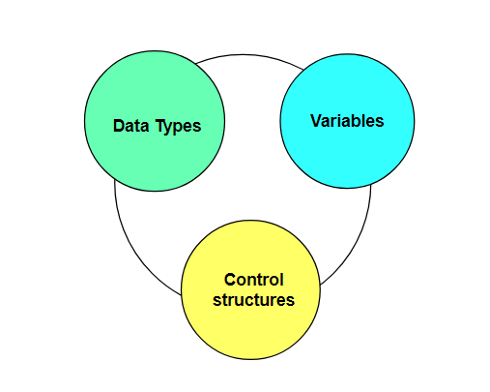
Java core
Basics of Java programming
Understand basic of Java:
+ Data types in java.
+ Variables in java.
+ Types of control structures.

Slide 11
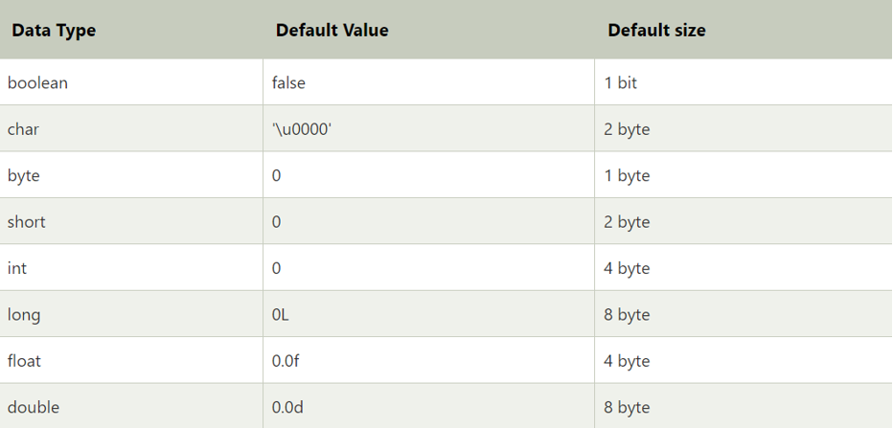
Java core
Data types (Primitive data types)
Understand Data Types:
+ Different in primitive data types.
+ Storage size of each type.

Slide 12
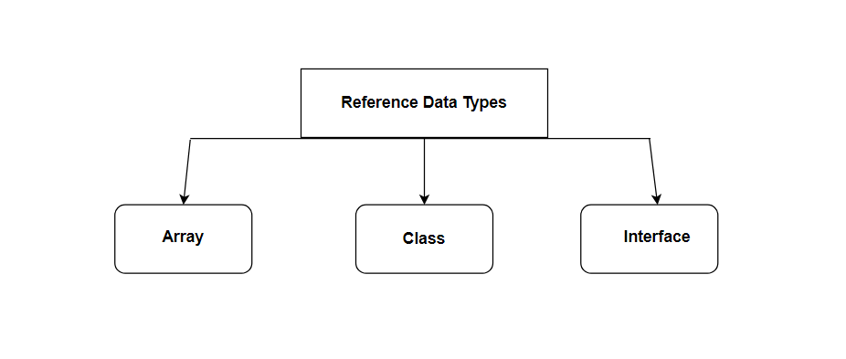
Java core
Data types (Reference data types)
Understand Data Types:
+ Different in Reference data types.
+Know how to use each type

Slide 13
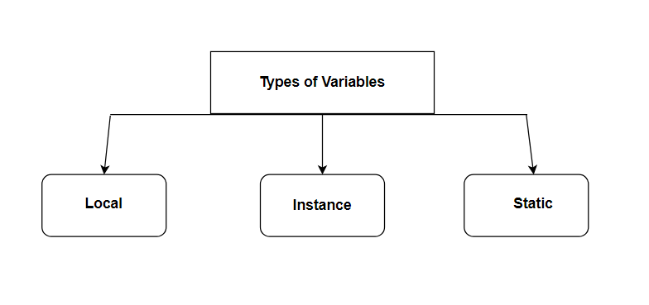
Java core
Variables
Understand Variables:
+ Understand the function of each variable.
+ Understand the usage of each variable.

Slide 14
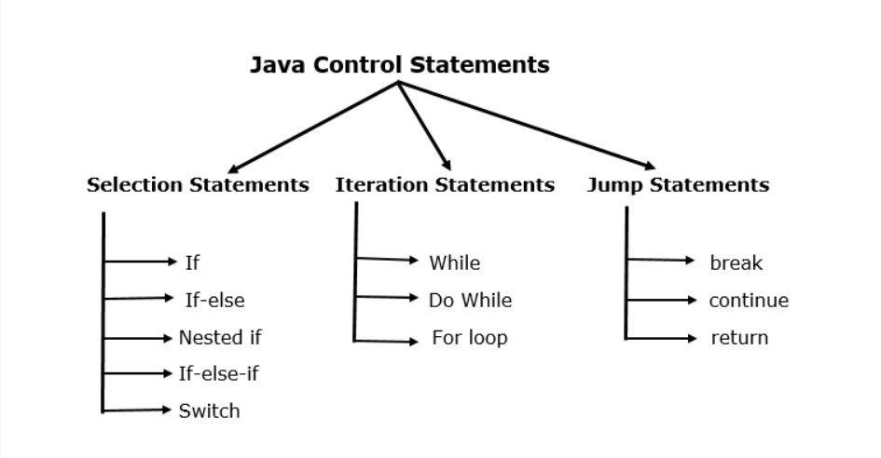
Java core
Control structures
Understand about Control Structures:
+ The function of each conditional statement.
+ Structure of each conditional statement.

Slide 15
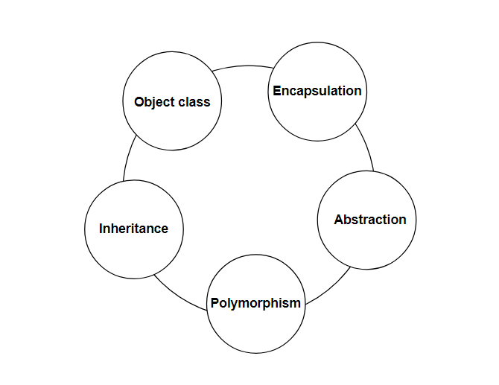
Java core
OOP (Object Oriented Programming)
Understand about OOP:
+ Is a method of programming in Java.
+ Allows you to organize and manage your source code more easily using objects, classes, and related concepts.

Slide 16
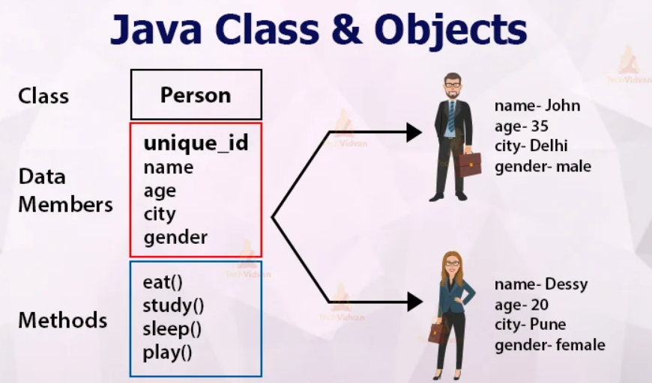
Java core
OOP (Objects class)
Understand about Objects class:
+ Is a base class from which every other class directly or indirectly inherits.

Slide 17
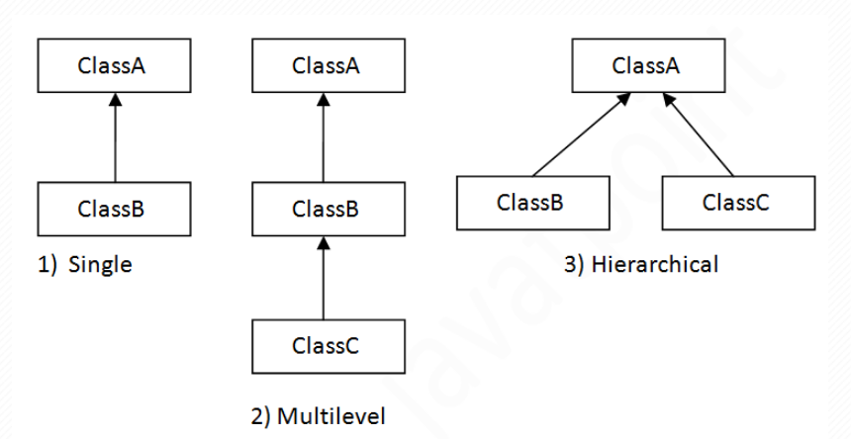
Java core
OOP (Inheritance)
Understand about Inheritance:
+ Is the relationship between two classes.
+ When inheritance a child class, all method and properties of the parent class are inherited.

Slide 18
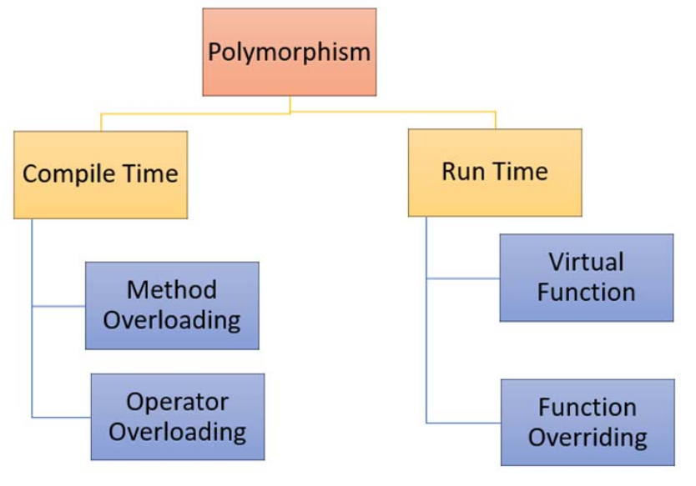
Java core
OOP (Polymorphism)
Understand about Polymorphism:
+ An action can be performed in many different ways.

Slide 19
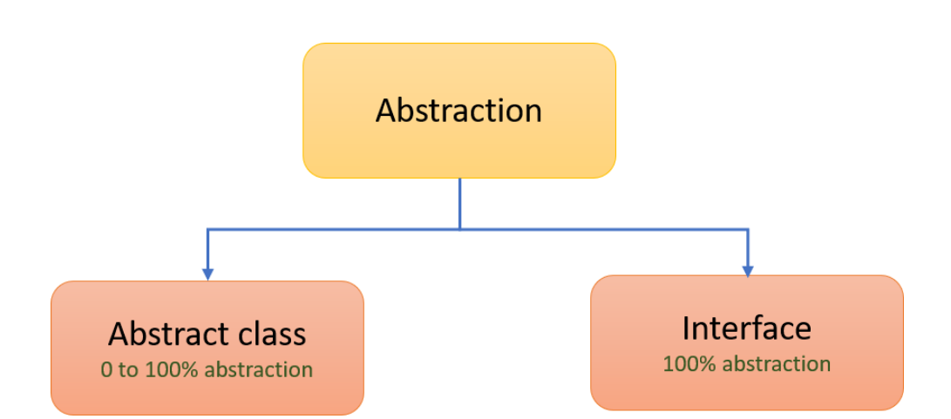
Java core
OOP (Abstraction)
Understand about Abstraction:
+ Show only the important details.
- Abstract class.
- Interface.

Slide 20
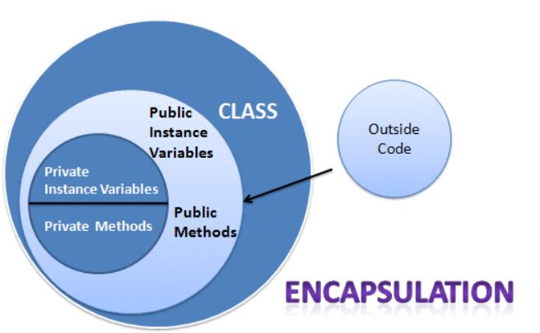
Java core
OOP (Encapsulation)
Understand about Encapsulation:
- Only relevant information is displayed
- Reduce software development complexity.

Slide 21
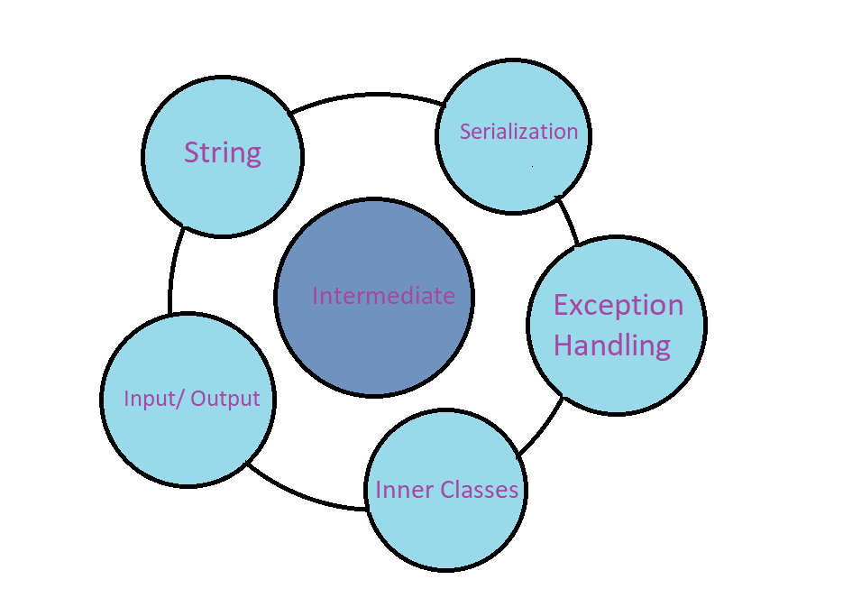
Java core
INTERMEDIATE

Slide 22
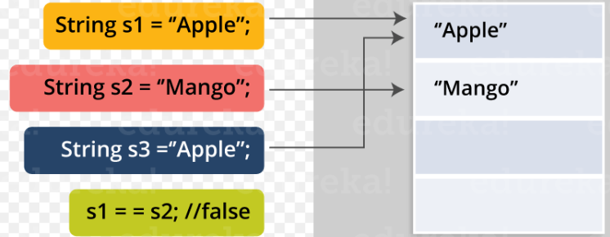
Java core
INTERMEDIATE (String)
Understand about String:
- Methods for working with strings.

Slide 23
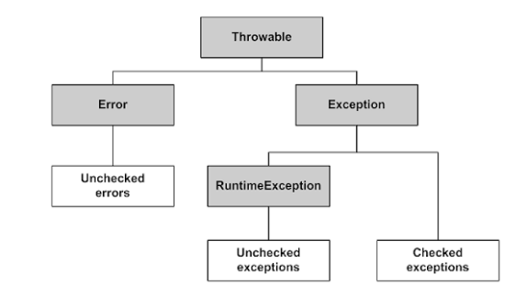
Java core
INTERMEDIATE (Exception Handling)
Understand about Exception Handling:
Is a event that has been breaking the processing lines.
There are 3 types :
+ Checked Exceptions.
+ Unchecked Exceptions.
+ Error.

Slide 24
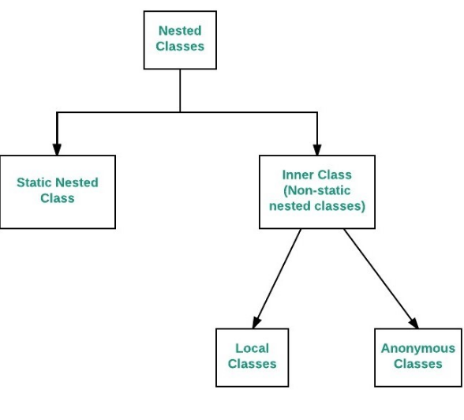
Java core
INTERMEDIATE (Inner Classes)
Understand about Intermediate:
- Used to manipulate input and output data from the program.

Slide 25
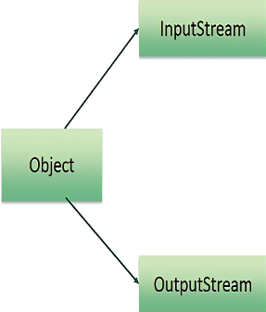
Java core
INTERMEDIATE (Input/ Output)
Understand about Input/ Output:
- Used to manipulate input and output data from the program.

Slide 26
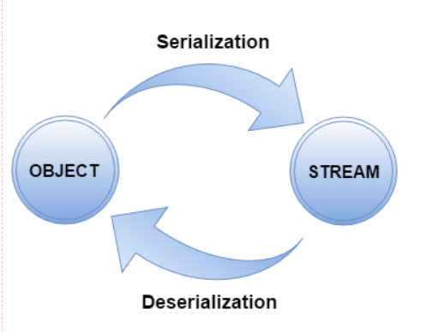
Java core
INTERMEDIATE (Serialization)
Understand about Serialization:
Is the process of converting an object into a byte data form for storage or transmission over a network.
Data storage, can restore the state of the object.

Slide 27
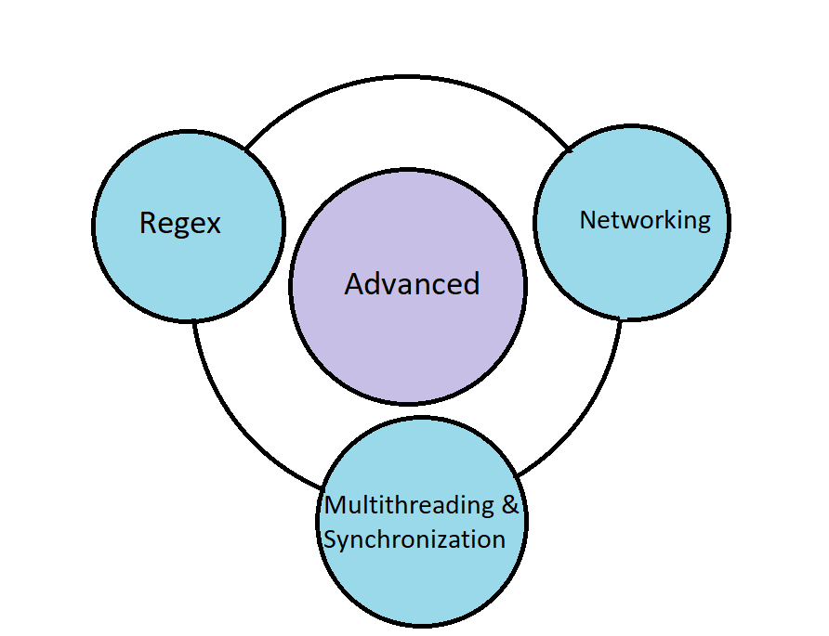
Java core
ADVANCED

Slide 28
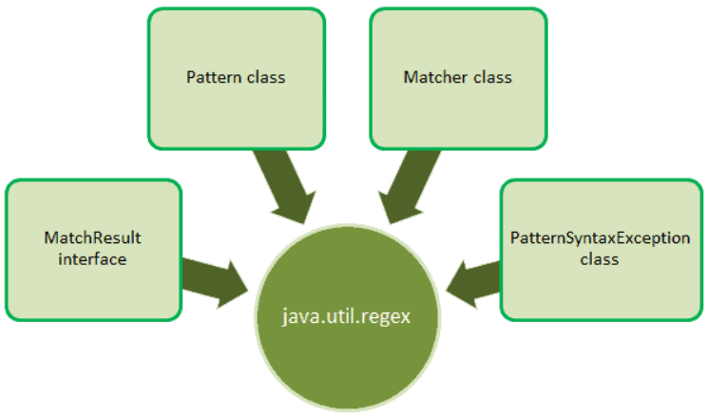
Java core
ADVANCED (Regex)
Understand about Regex:
- Used to define a pattern for searching by string, comparing strings, determining data types, ...
- Provides classes and interface in the java.util.regex package.

Slide 29
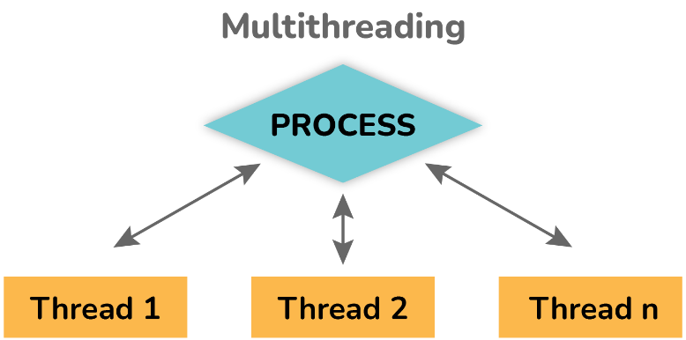
Java core
ADVANCED (Multithreading)
Understand about Multithreading:
Is a process that executes multiple threads concurrently.

Slide 30
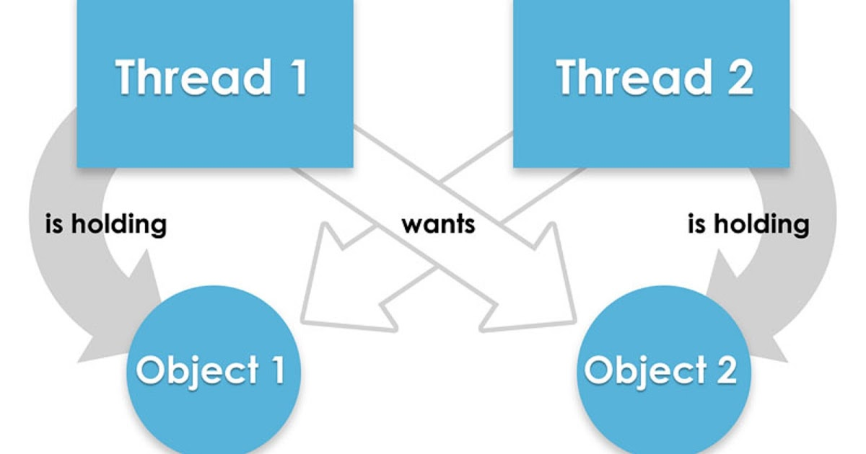
Java core
ADVANCED (Synchronization)
Understand about Synchronization:
Is the ability to control multiple thread’s access to any shared resource.

Slide 31
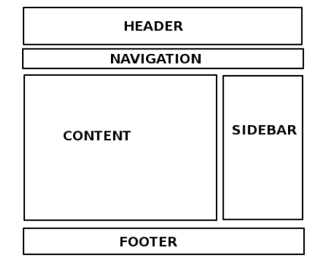
Front-End Basic
HTML (Hyper Text Markup Language)
Understand basic of HTML:
+ Basic view consists of: the header, the
body, and the footer.
+ Is the basic language for building and formatting web pages.
+ Basic tags in HTML.

Slide 32
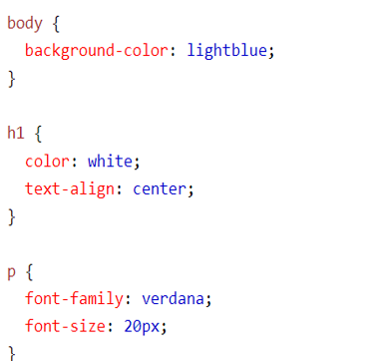
Front-End Basic
CSS(Cascading Style Sheets)
Understand basic of CSS:
+ Is a language used to reformat eleme.
+There are three ways to apply CSS to
an HTML page.
- Inline CSS
- Internal
- External

Slide 33
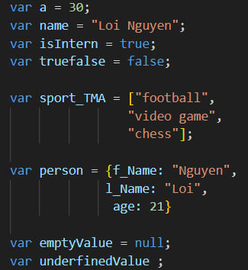
Front-End Basic
JavaScript
Understand basic of JavaScript:
+ Is a programming language used to create interactive websites and dynamic applications.
+ Variables and data types.
+ Conditional statement.

Slide 34
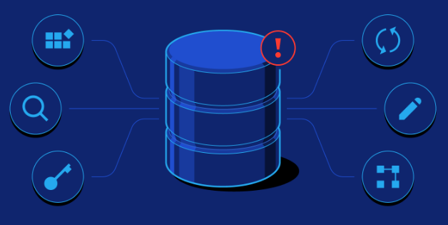
SQL
Database
Understand Database in SQL :
+ Is a structured query language for
data management.
+ Allow access and perform query operations, change data.

Slide 35
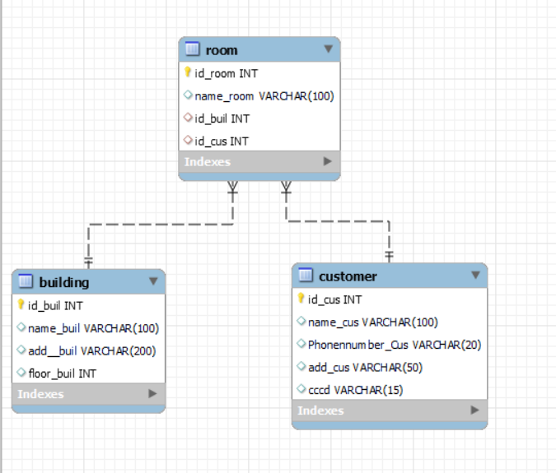
SQL
Table, Row
Understand Table, Row in SQL:
+ A table is a collection of similarly structured data.
+ The data is organized into rows and columns.
+ Each table in SQL has a unique
name and consist of columns and rows.

Slide 36
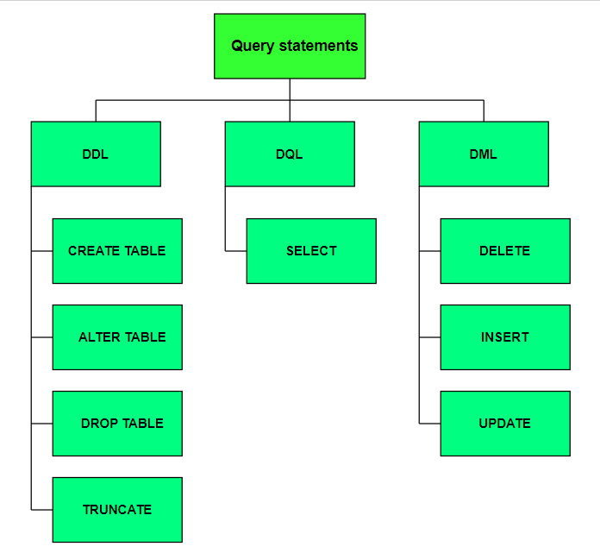
SQL
Query
Understand query statements:
+ Are statements used to retrieve
data from the database.
+ Perform other operations such as updating, deleting, adding new data.

Slide 37
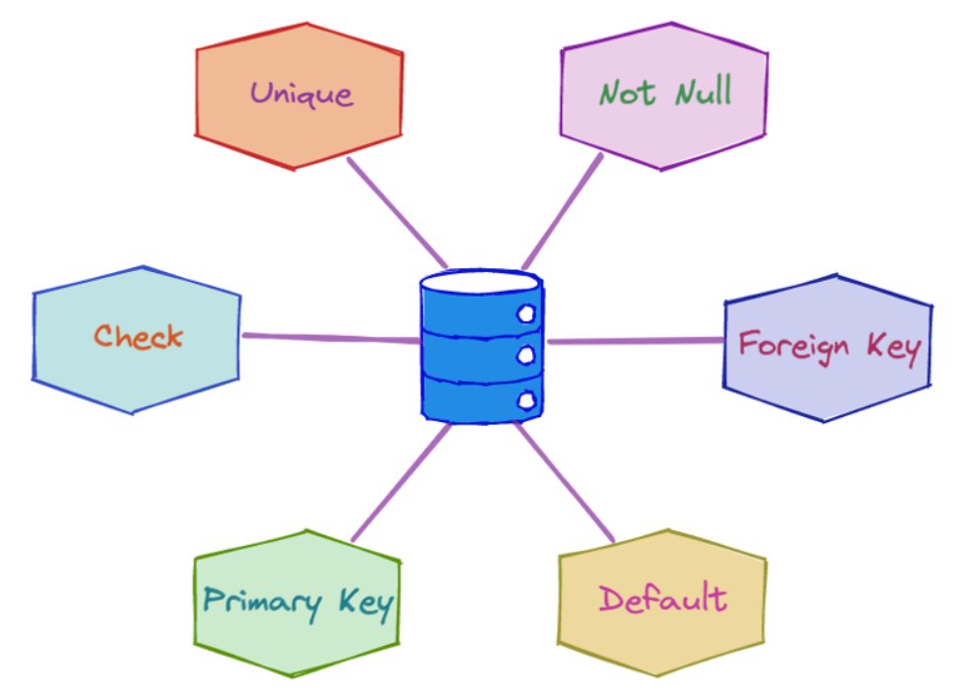
SQL
Constraint
Understand Constraint in SQL:
+ Impose rules or limits on the data
in the database .
+ensure data integrity and accuracy.
+ Types of constraint: Not null, Unique, Primary key, Foreign key, Check, Default.

Slide 38
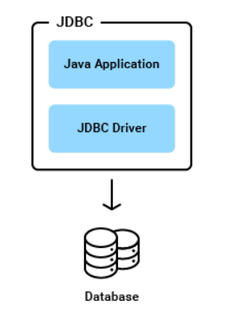
SQL
JDBC (Java Database Connectivity)
Understand JDBC in SQL:
+ Is a API used to connect and execute SQL statements to the database.
+ The main interfaces include :
- Connection.
- PreparedStatement/ Statement.
- ResultSet.
+ Connect MySql database using JDBC.

Slide 39
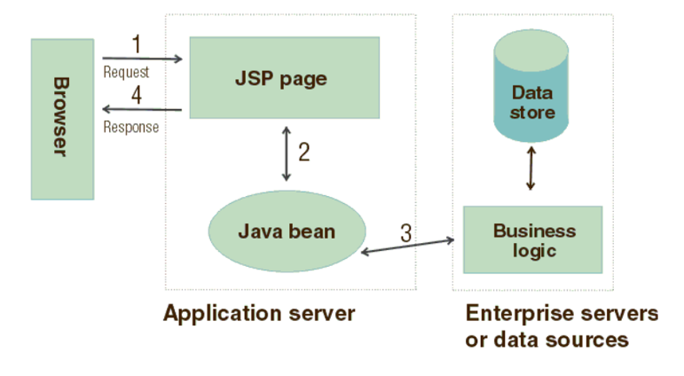
Java Server Pages
JSP Architecture
Understand JSP architecture:
+ Function of each part
+ Processing when a request is sent to the browser.

Slide 40
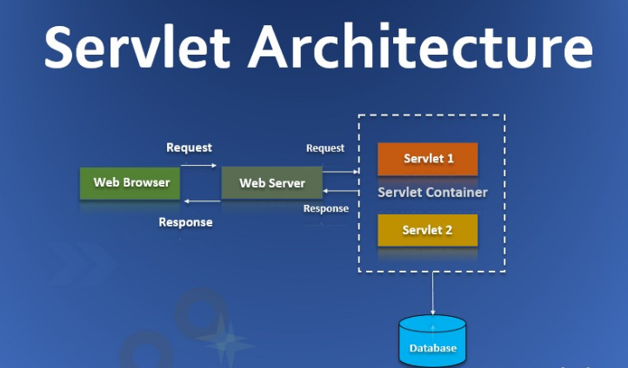
Servlet
Servlet Architecture
Understand Servlet architecture:
+ Function of each part
+ Processing when a request is sent to the browser.

Slide 41
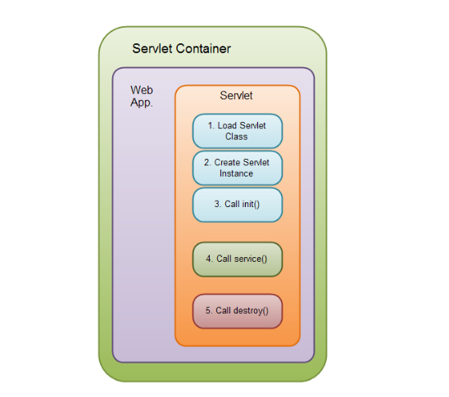
Servlet
Servlet Lifecycle
Understand Servlet lifecycle:
+ The lifecycle of a Servlet is the process that a Servlet object goes through from creation to destruction

Slide 42
JSTL
IOC ( I
Basic understand of Spring:
+

Slide 43
MVC model
IOC ( I
Basic understand of Spring:
+

Slide 44
Execution Environment
Apache Tomcat
Basic understand of Spring:
+

Slide 45
Thank you!

